Slide 1
Scaled Agile Framework
(SAFe ®)

Slide 2
What is SAFe?
The Scaled Agile Framework (SAFe®) is a set of organization and workflow templates designed to guide enterprises in scaling agile and agile practices.
SAFe synchronizes alignment, collaboration, and delivery for multiple flexible teams. SAFe, scalable and configurable, allows each organization to adapt it to their business needs.
SAFe describes the roles, responsibilities, artifacts, and actions required to implement Lean-Agile development.

Slide 3
SAFe Configurations
SAFe supports a full range of development environments with four ready-made configurations:
Essential SAFe
Portfolio SAFe
Large Solution SAFe
Full SAFe

Slide 4
Essential SAFe
Essential SAFe configuration is the heart of the platform and is the easiest starting point to implement. This is the main building block for all other SAFe configurations and describes the most important elements needed to realize most of the benefits of the Framework. Together, the team and program levels form an organizational structure called the Agile Release Train (ART), where agile teams, key stakeholders, and other resources are allocated to fulfill an important ongoing task.

Slide 5
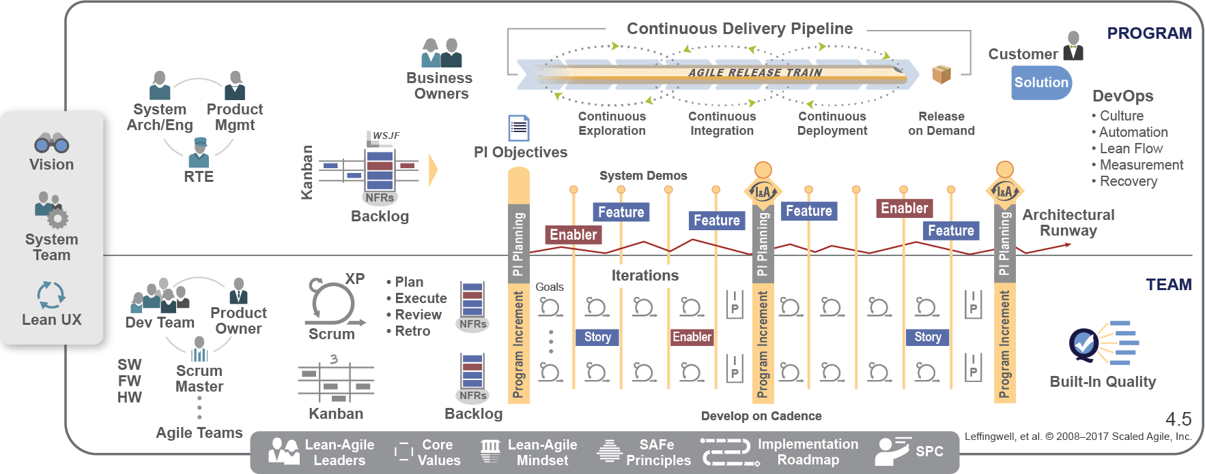
Essential SAFe
Essential SAFe consists of the command and program levels.

Slide 6
Large Solution SAFe
SAFe configuration for large solutions is designed to develop the largest and most complex solutions, which usually require several Agile releases and vendors, but do not require portfolio-level considerations. This is characteristic of industries such as aerospace and defense, automotive and government, where the main issue is a major decision, not portfolio management.
The organizational structure of a high-level solution of the Solution Train helps enterprises that face the most serious problems - create large-scale multidisciplinary software, equipment and complex IT systems. Creating these solutions requires additional roles, artifacts, events, and coordination. Enterprises that create largely independent systems or those that can be built with several hundred practitioners may not need this configuration.

Slide 7
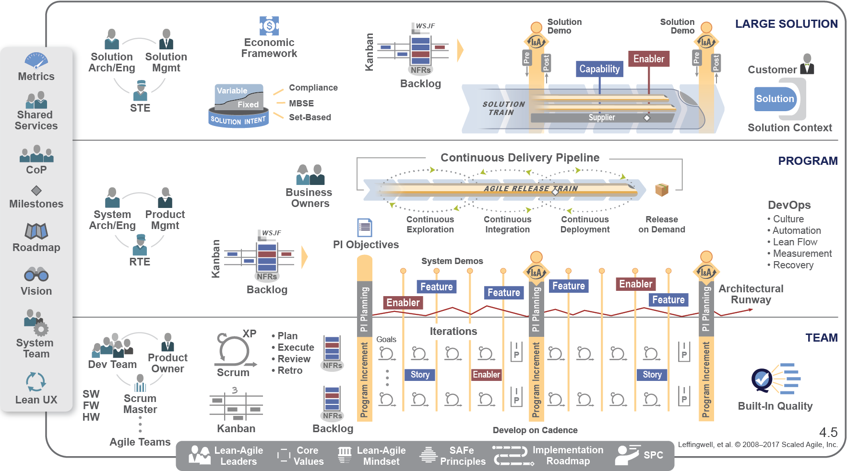
Large Solution SAFe

Slide 8
Portfolio SAFe
Portfolio SAFe configuration helps align portfolio execution with enterprise strategy by organizing agile development around a value stream through one or more value stream. It provides business agility through principles and practices for portfolio strategy and investment finance, Agile portfolio operations and Lean management.

Slide 9
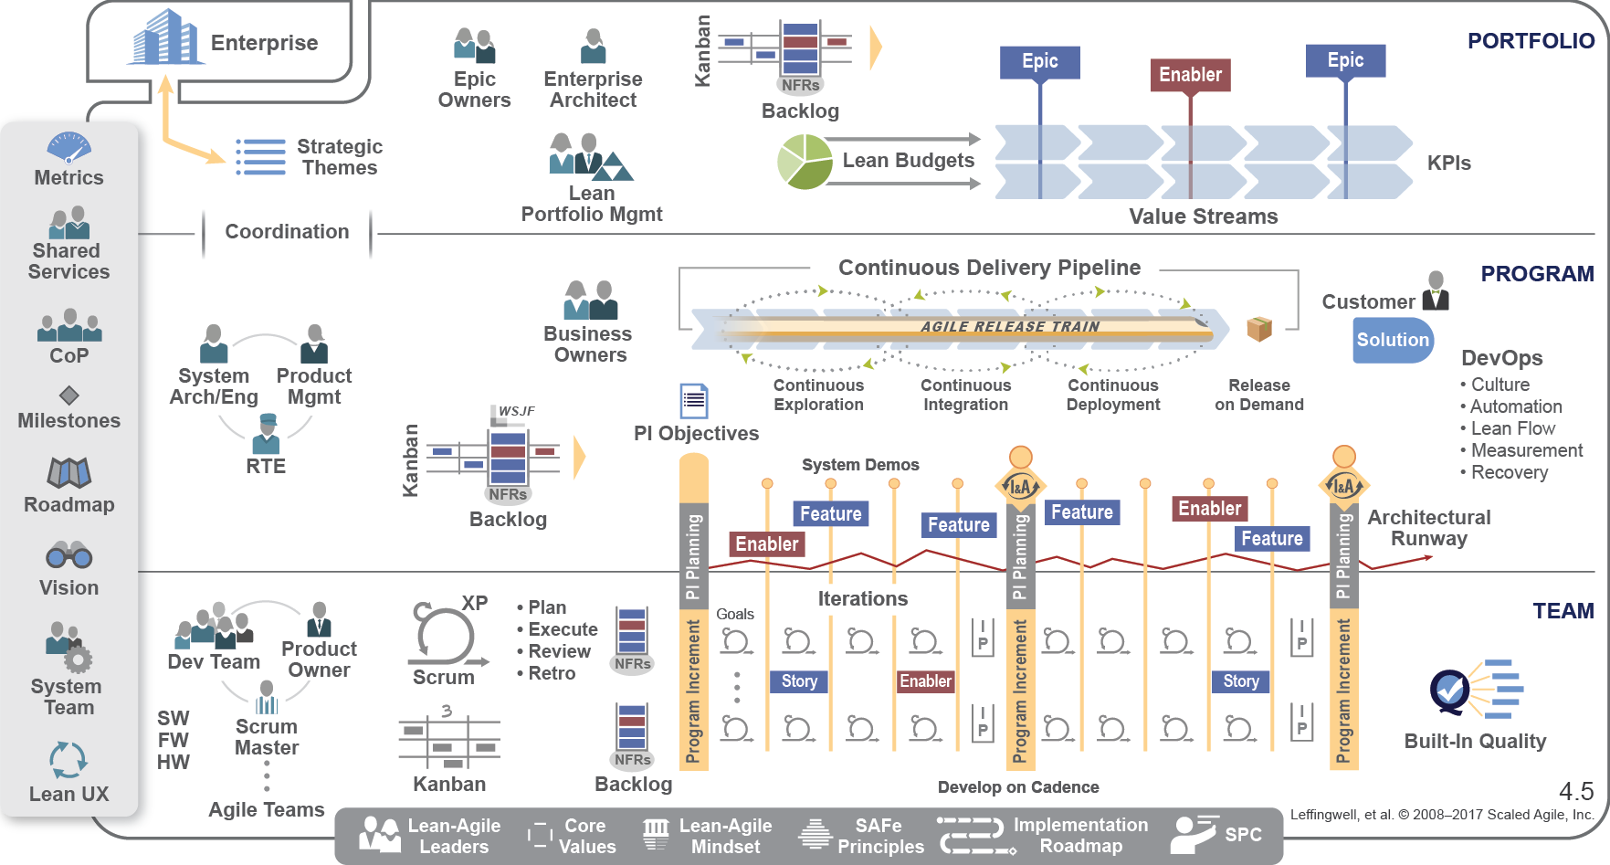
Portfolio SAFe

Slide 10
Full SAFe
Complete configuration SAFe is the most complete version of the Framework. It supports enterprises that create and support large integrated solutions that require hundreds or more people, and includes all levels of SAFe: team, program, large solution and portfolio. Larger enterprises may require multiple instances of various SAFe configurations.

Slide 11
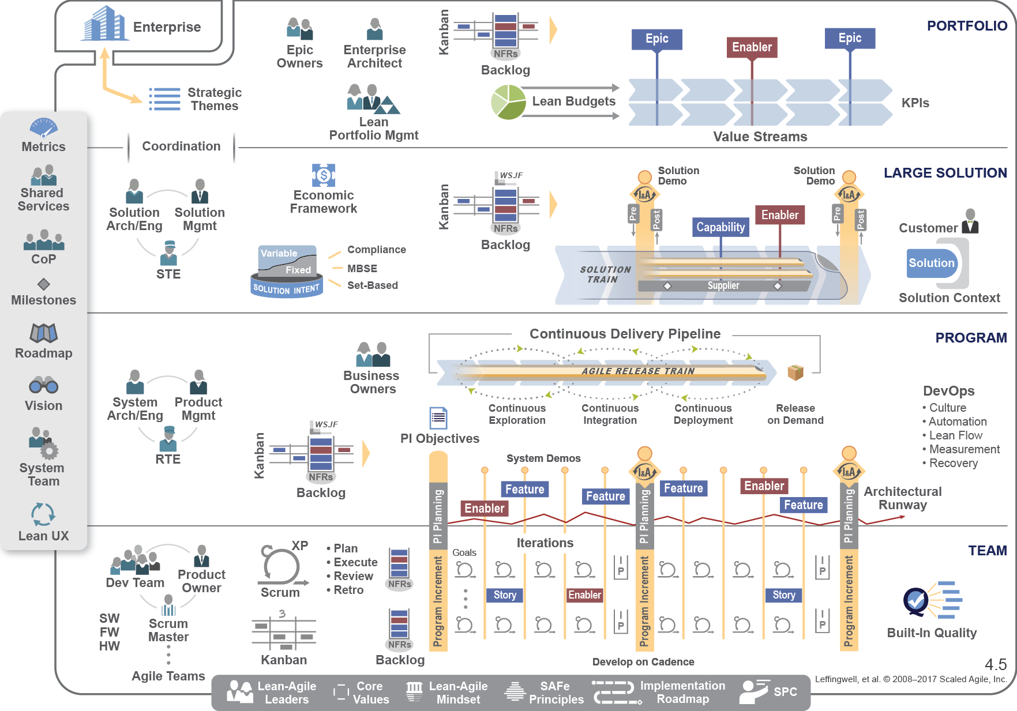
Full SAFe

Slide 12
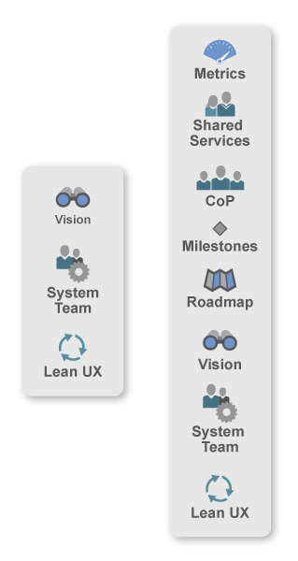
The Spanning Palette
Metrics. The main measure in SAFe is the objective measurement of working solutions. In addition, SAFe defines some additional intermediate and long-term indicators, as well as metrics that teams, programs and portfolios can use to measure progress.
Shared Services - Represents special roles that are necessary for the success of an ART or value stream, but which cannot be allocated for a full day of any particular sequence.
Community of Practice (CoP). A community of practice is an informal group of team members and other experts within the framework of a program or enterprise who are called upon to share practical knowledge in one or more relevant areas.

Slide 13
The Spanning Palette
Milestones - A milestone is used to track progress towards a specific goal or event. These include fixed date, program growth (PI), and learning steps.
“Roadmap” - “Roadmap” displays the planned results of ART and the value stream and the main steps in the timeline.
Vision - Vision describes the future vision of a solution that will be developed, reflecting the needs of customers and stakeholders, as well as the features and capabilities that are offered to meet these needs.
The system team is a dedicated Agile team that helps create and use the Agile development environment, including continuous integration, test automation, and delivery pipeline automation.

Slide 14

The Foundation
Lean-Agile Leaders - Management is primarily responsible for business results. Leaders must be trained and then become instructors of these more subtle ways of thinking and acting. To this end, SAFe describes a new leadership style demonstrated by company managers.
Core Values ​​- Four core values ​​define the belief system for SAFe: alignment, built-in quality, transparency, and program execution.
Lean-Agile Mindset - Lean-Agile Leaders are students and teachers throughout life. They understand and adhere to the principles and practices of Lean and Agile.

